Slide 1
HOSPITAL MANAGEMENT SYSTEM

Slide 2
DESCRIPTION ABOUT HOSPITAL MANAGEMENT SYSTEM
Our project Hospital Management system includes registration of patients, storing their details into the system , and validation of user. Patient can book an appointment with the doctor by logging in , And Patient can also log out .User can search availability of a doctor and the details of a patient using the id.
The Hospital management system can be entered using a username and password . It is even accessible either by an admin or doctor.

Slide 3
Link
http:://github.com/PradhikshaNandini/Django-Project.git

Slide 4
CONTRIBUTION
*Login ,Sign Up ,Admin :1)T .Pradhiksha Nandini 2)Rishika Malla
*Web Designing By Gagana R

Slide 5
Screenshots

Slide 6
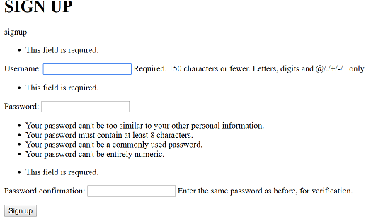
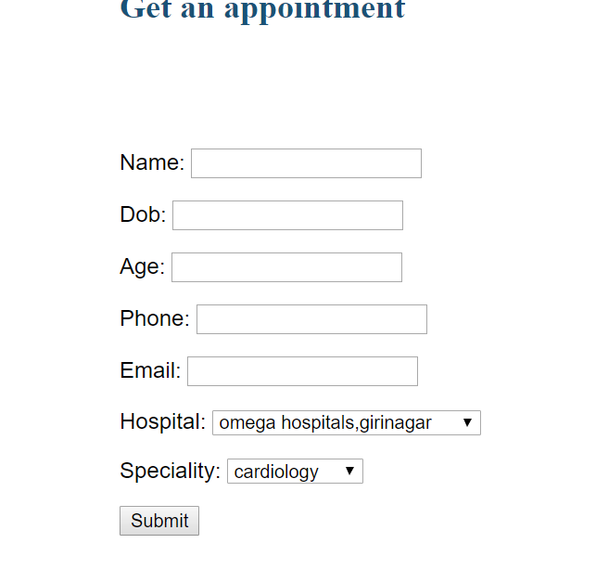

Slide 7
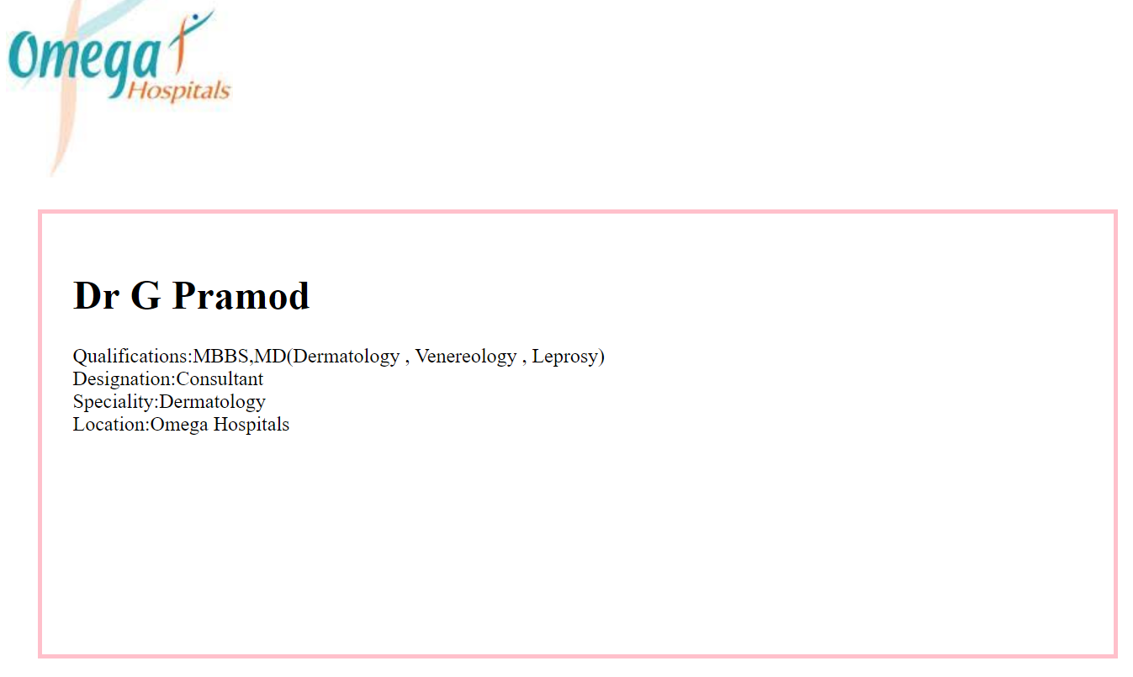
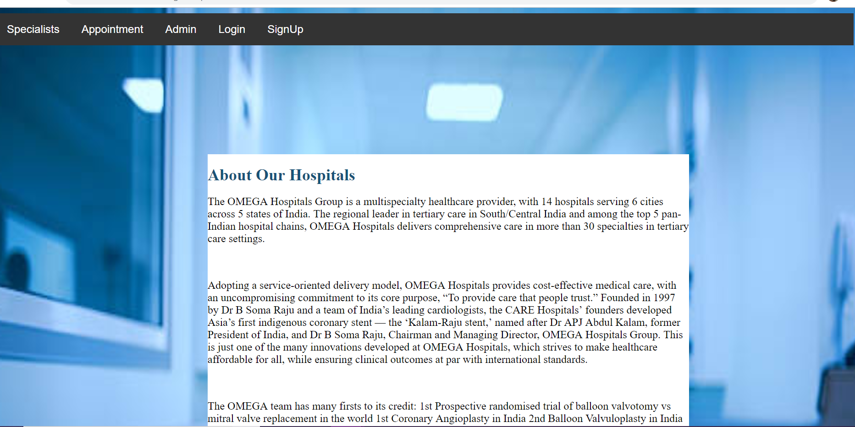

Slide 8
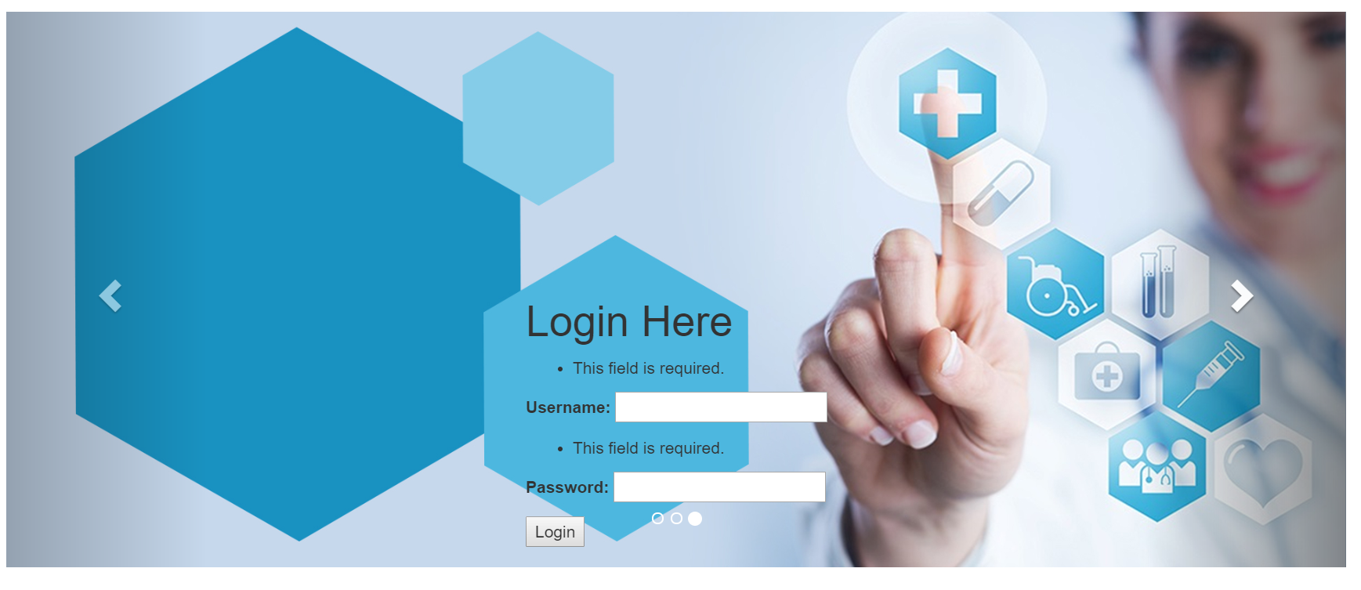

Slide 9
TAKEAWAYS
*How to create the models and forms
*How to do authentication

Slide 10
CHALLENGES
*How to place models in model.py and view.py
*while hosting in python anywhere
*while hosting in github

Slide 11
CONTACT INFORMATION
NAME:T P NANDINI
SRN:PES1201700064
EMAIL:tpnandini99@gmail.com
NAME:RISIKA MALLA
SRN:PES1201700162
EMAIL:rishikasmily2706@gmail.com
NAME:GAGANA R
SRN:PES1201701618
EMAIL:gagana.ramakrishnappa@gmail.com

